Slide 1
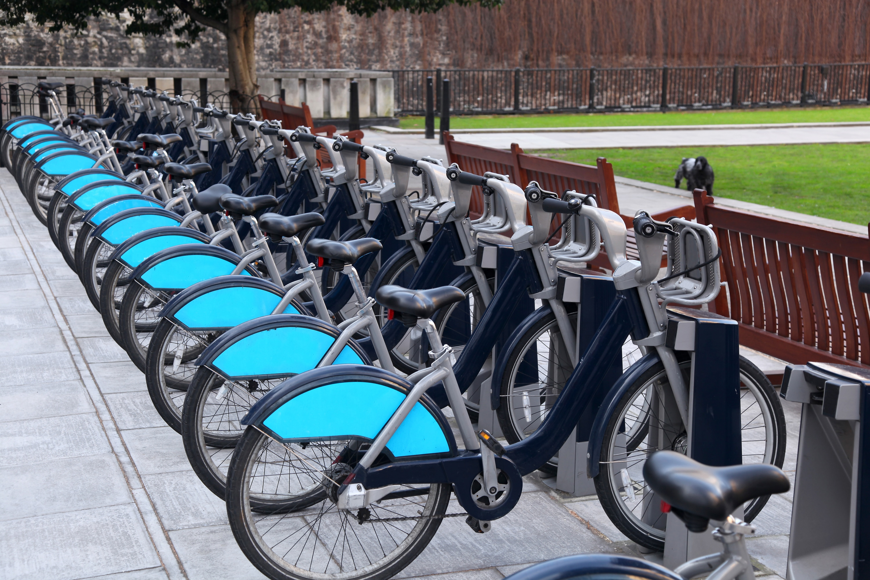
Bike Share Case Study
By Shaun Evans

Slide 2
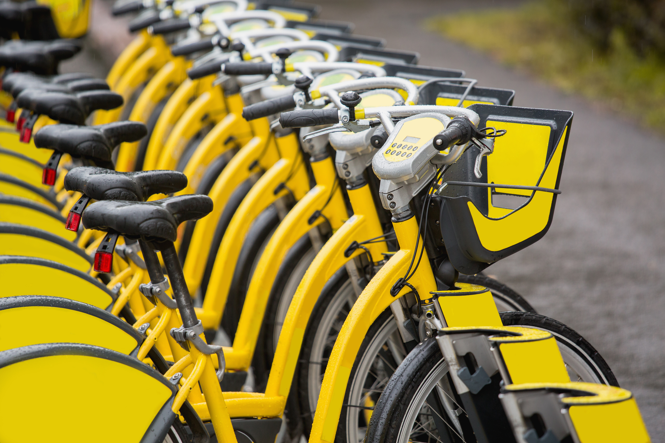
Case Study Outline
Organization Overview
Business Tasks
Data Sources, Cleaning, and Presentation
Analysis
Visualizations
Business Summary
Business Recommendations
Scope Limitations of Analysis

Slide 3
Organization Overview
Cyclistic is a fictitious bike sharing service operating out of Chicago, Illinois.
With more than 5,800 bicycles and 600 docking stations, Cyclistic offers its services to both members and non-members.
Cyclistic has identified that riders using annual memberships are a more profitable consumer base compared to casual riders and is seeking insight on the differences between casual riders compared to members for a marketing campaign.

Slide 4
Business Tasks
Identify the following:
How do annual members and casual riders use Cyclistic bikes differently?
Why would casual riders buy Cyclistic annual memberships?
How can Cyclistic use digital media to influence casual riders to become members?

Slide 5
Data Sources, Cleaning, and Presentation
Cyclistic’s historical data set was provided fort this analysis
This data is first-party data made available under license in the form of .csv spreadsheets
Data has been selected for the period of May 2020 – March 2021
Data included non-identifying trip information, including ride id, start location, end location, and bike types
Data excludes identifying demographic details for riders
Data Cleaning
Data will be cleaned, merged into uniform data frame, and examined using SQL
Preliminary visualizations will be created in Python using Seaborn and Matplotlib (PyPlot) packages
Data will be presented in Power Point and as a Tableau dashboard for stakeholder use

Slide 6
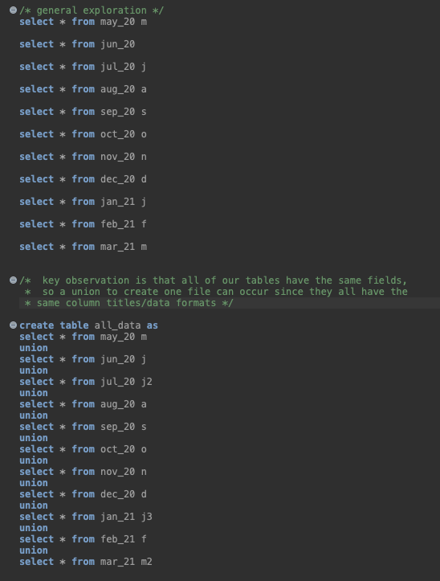
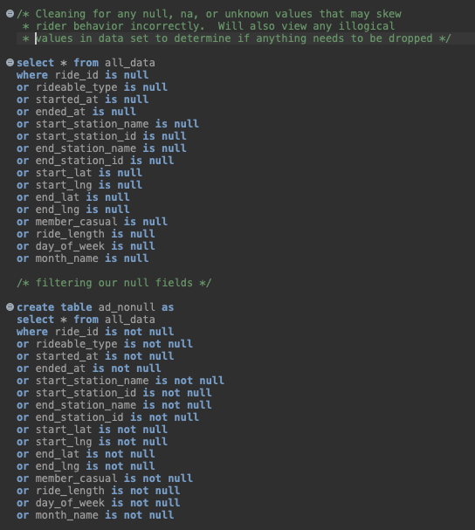
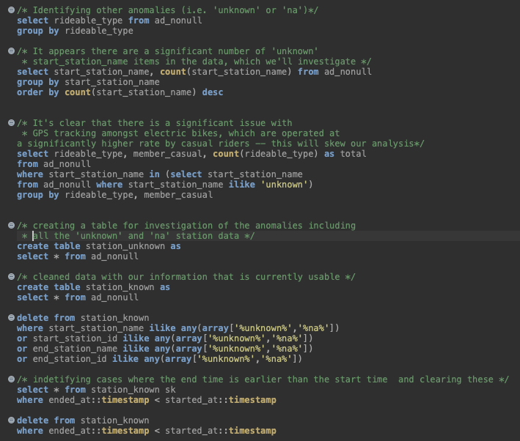
SQL Cleaning/Preparation

Slide 7
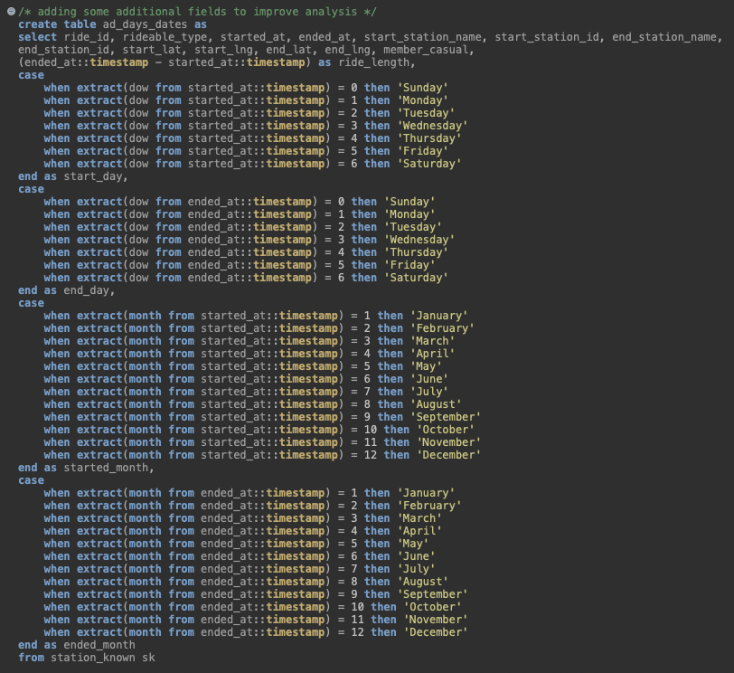
SQL Cleaning/Preparation

Slide 8
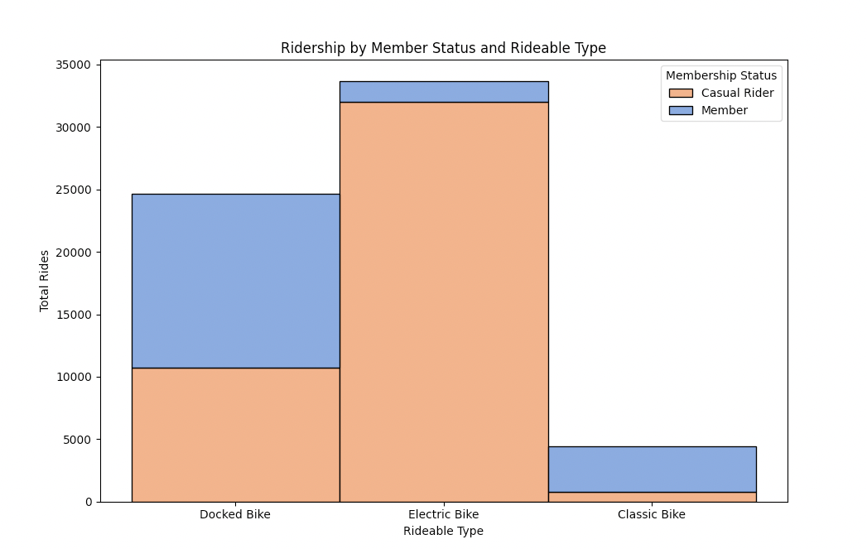
Cyclistic Analysis
How do annual members and casual riders use Cyclistic bikes differently?
Product
Casual riders tend to use electric and docked bikes almost exclusively, whereas members favor docked or classic bikes for their normal usage.

Slide 9
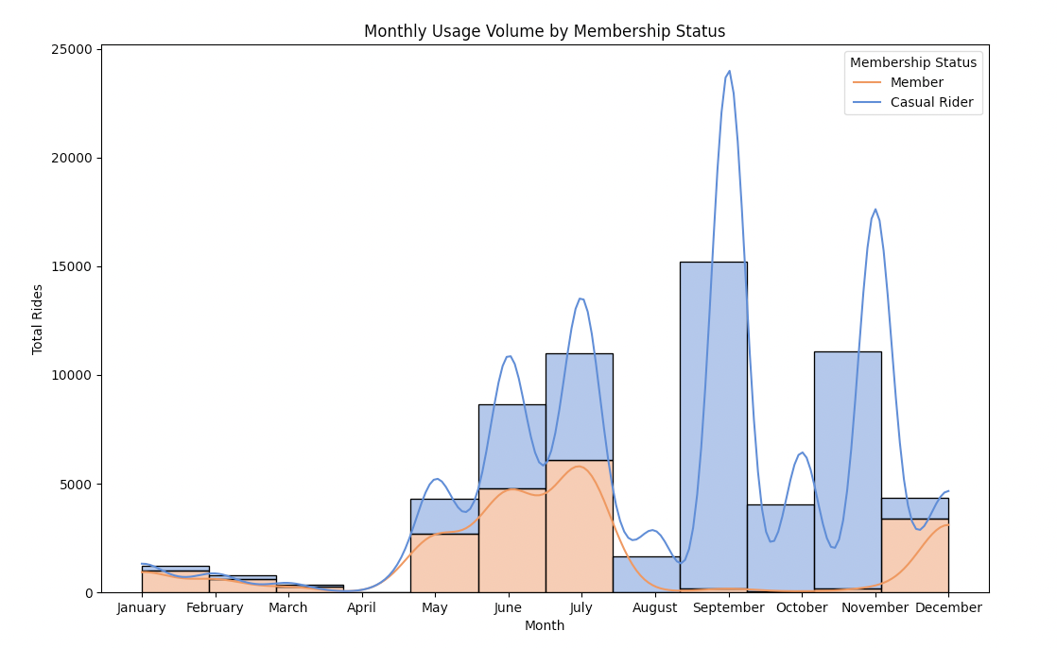
Cyclistic Analysis
Usage Patterns
The key use months for member are during the late spring/summer (May, June, July) and around the holidays (December).
Casual riders have a steady growth pattern through the summer, but the highest volume months are September and November.
Notes:
Python Code:
sns.histplot(data=df2, x='monthnum', hue='member_casual', multiple='stack', palette='muted', kde=True, bins=12) plt.xticks([1,2,3,4,5,6,7,8,9,10,11,12],['January','February','March','April', 'May','June','July','August','September', 'October','November','December']) plt.title("Rider Behavior by Membership Status - Monthly") plt.ylabel("Total Rides") plt.xlabel("Month") plt.legend(title="Membership Status", labels=['Member','Casual Rider']) plt.show()

Slide 10
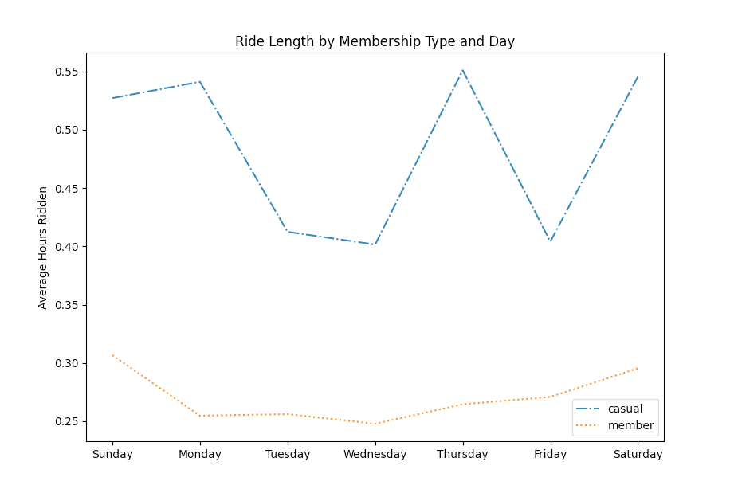
Cyclistic Analysis
Usage Patterns (Continued)
Members tend to use Cyclistic bikes for shorter periods.
This suggests bikes are used for utility, rather than leisure (i.e. commute, errands, etc.)
Casual Riders use bikes for longer periods across the board
This suggests bikes are likely being used for leisure, rather than as a primary source of transportation
Notes:
Python Code:
sns.histplot(data=df2, x='monthnum', hue='member_casual', multiple='stack', palette='muted', kde=True, bins=12) plt.xticks([1,2,3,4,5,6,7,8,9,10,11,12],['January','February','March','April', 'May','June','July','August','September', 'October','November','December']) plt.title("Rider Behavior by Membership Status - Monthly") plt.ylabel("Total Rides") plt.xlabel("Month") plt.legend(title="Membership Status", labels=['Member','Casual Rider']) plt.show()

Slide 11
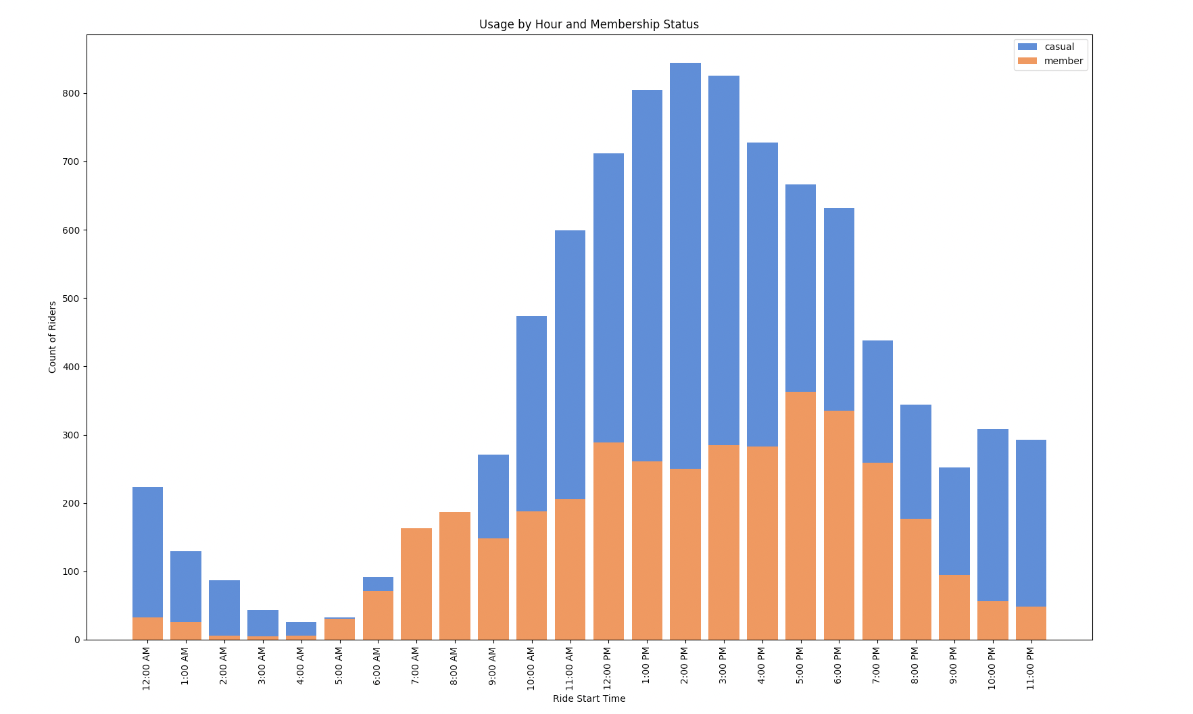
Cyclistic Analysis
Usage Patterns (Continued)
Casual riders start ride during ‘off-peak’ times at a much higher rate than members, which is also indicative of leisure type use of the bikes.
Notes:
Python Code:
sns.histplot(data=df2, x='monthnum', hue='member_casual', multiple='stack', palette='muted', kde=True, bins=12) plt.xticks([1,2,3,4,5,6,7,8,9,10,11,12],['January','February','March','April', 'May','June','July','August','September', 'October','November','December']) plt.title("Rider Behavior by Membership Status - Monthly") plt.ylabel("Total Rides") plt.xlabel("Month") plt.legend(title="Membership Status", labels=['Member','Casual Rider']) plt.show()

Slide 12
Business Summary
How do annual members and casual riders use Cyclistic bikes differently?
Casual users and members have vastly different riding norms:
Casual users tend to cluster during the weekend, during ‘off-business’ hours, and over the course of the summer until a crescendo of usage in the late fall, along with the holiday period.
Casual users ride Cyclistic products significantly longer than their member counterparts, and have different preferred riding start and stop locations (by volume)
Casual users also have a tendency to lean towards more modern products (i.e. electric bikes), likely as a byproduct of their more casual and lengthy riding patterns
Why would casual riders buy Cyclistic annual memberships?
Reason #1 – Improved Product Availability (i.e. peak time availability and preferred product availability)
Reason #2 – Potential for pricing incentives
Reason #3 – Convenience versus alternative transportation – as an outcome of implementing a pricing/availability strategy, Cyclistic can market the potential benefits and convenience of Cyclistic products for members (i.e. first choice) versus non-members
How can Cyclistic use digital media to influence casual riders to become members?
Consider offering membership packages for tourists, travelers, and individuals who tend to be sigh—seeing (i.e. top destinations) to capture the non-member demographic
Consider marketing the perks of membership (reservations compared to first come, first served) and convenience of use with a membership

Slide 13
Business Recommendations
Implement a marketing campaign that targets the following:
Pricing benefits for members vs. non-members (i.e. a reduced-price membership for travelers/weekenders)
Accessibility to electric bikes (primarily) and docked bikes (secondarily)
Availability of these products through a reservation system for members, vs. a first-come, first-served model for non-members
Convenience – make sure Cyclistic products are available for members based on usage history at their normal places of operation/popular destination

Slide 14
Scope Limitations of Analysis
Data Limitations
All data is anonymized, and lacks demographic factors that could improve the recommendations of this analysis, such as:
Residence location for casual users
ID information to track repetitious usage of non-members (and members)
Age, Gender, and Income tier of Cyclistic’s users

